Slide 1


Project Phase 2: Screening Presentation on “Attendance and Sanitization management”
Students:
Anurag V S (1RN16CS012)
Smaran S (1RN16CS105)
Shreyas M (1RN17CS419)
Guide:
Dr. Kiran P
Professor and Head of Department,
Dept. of CSE, RNSIT
Department of Computer Science and Engineering
RNS Institute of Technology
2020-21

Slide 2
CONTENTS
INTRODUCTION
Background work
Problem Statement
Existing System and Limitations
Proposed system
REQUIREMENTS
Hardware & Software Requirements
FLOW CHART
Flow Chart
INNOVATIVENESS & USEFULNESS
IMPLEMENTATIONS
CONCLUSION
REFERENCES

Slide 3
INTRODUCTION
COVID-19 has had drastic effects on the working environment of various organizations.
It has made working in an office space a risk factor.
A person who hasn’t sanitized himself, poses danger to himself and his colleagues.
Existing attendance systems cannot be used as it does not offer the contactless feature.

Slide 4
INTRODUCTION
There is no existing system to autonomously check if a person has sanitized or not.
The various attendance systems existing cannot be used as it poses risk by getting people in contact with one another.
Problem Statement-
Sanitization monitoring and no-contact attendance must be introduced in the working environment in a cost-effective manner.

Slide 5
INTRODUCTION
Proposed Solution –
To enforce a safe working environment we have developed a system of autonomous attendance and sanitization monitoring using computer vision concepts.

Slide 6
HARDWARE AND SOFTWARE REQUIREMENTS
Hardware Requirements
720P Camera
Intel i5 or equivalent Processor
8GB RAM
2GB or mode dedicated graphics
Software Requirements
IDE(Atom, VisualStudio, etc.,)
Python 3+/Anaconda
OpenCV Library
face_recognition package
Five or more images of each employee

Slide 7
INNOVATIVENESS & USEFULNESS
This system will help in stopping the spreading of virus while carrying on in our day to day life.
Even after the virus is obsolete, this will have many uses.
Face recognition and action recognition can be used in many other fields.
If we train the neural net to recognize different actions, it can be used in surveillance, simulations, etc.,

Slide 8
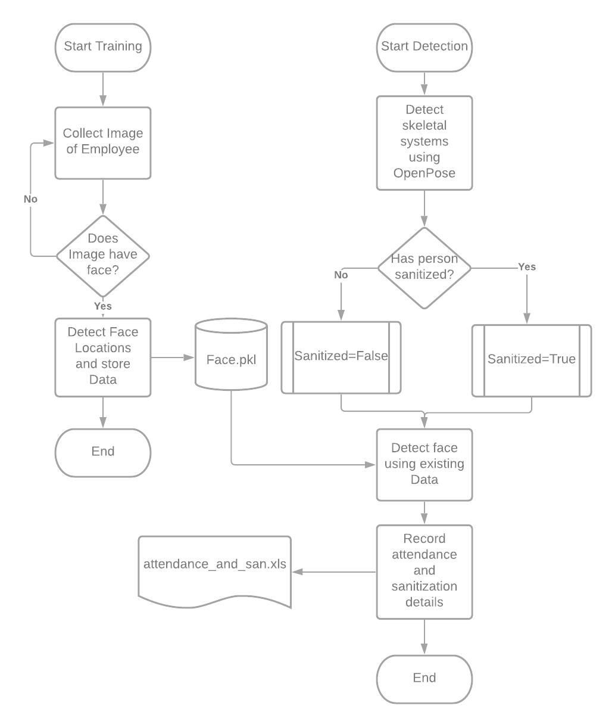
FLOW CHART

Slide 9
IMPLEMENTATION
Video processing will be done with the help of opencv library.
Face recognition will be done using dlib library.
E-Mail acknowledgement for attendance is done using yagmail.
Action recognition will be done using OpenPose.
Front-end has been implemented using PySimpleGUI.

Slide 10
IMPLEMENTATION
PySimpleGUI transforms the tkinter, Qt, WxPython, and Remi (browser-based) GUI frameworks into a simpler interface.
The window definition is simplified by using Python core data types understood by beginners (lists and dictionaries).
By definition, PySimpleGUI implements a subset of the underlying GUI frameworks' capabilities.

Slide 11
IMPLEMENTATION
We use 68 point face landmark method to extract features from image.
Detecting facial landmarks is a 2 step process-
Localize the face in the image
Detect key facial structure in face ROI
We use OpenCV’s haar-cascades to localize the face.
The facial landmark detector included in the dlib library is an implementation of the One Millisecond Face Alignment with an Ensemble of Regression Trees.
A training set of labeled facial landmarks on an image. These images are manually labeled, specifying specific (x, y)-coordinates of regions surrounding each facial structure.
Priors, of more specifically, the probability on distance between pairs of input pixels.

Slide 12
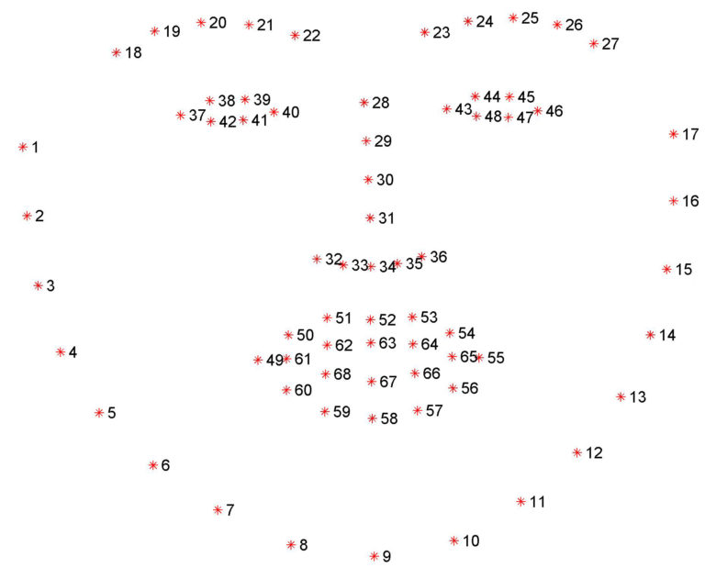
IMPLEMENTATION
Given this training data, an ensemble of regression trees are trained to estimate the facial landmark positions directly from the pixel intensities themselves.
The end result is a facial landmark detector that can be used to detect facial landmarks in real-time with high quality predictions.

Slide 13
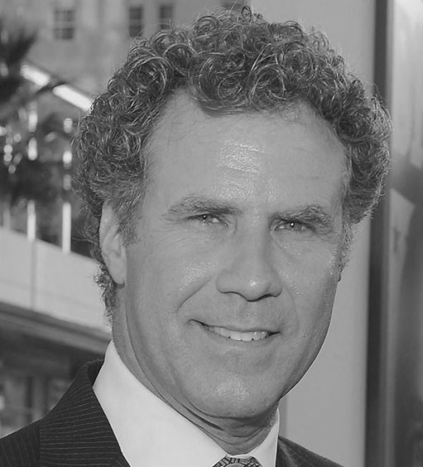
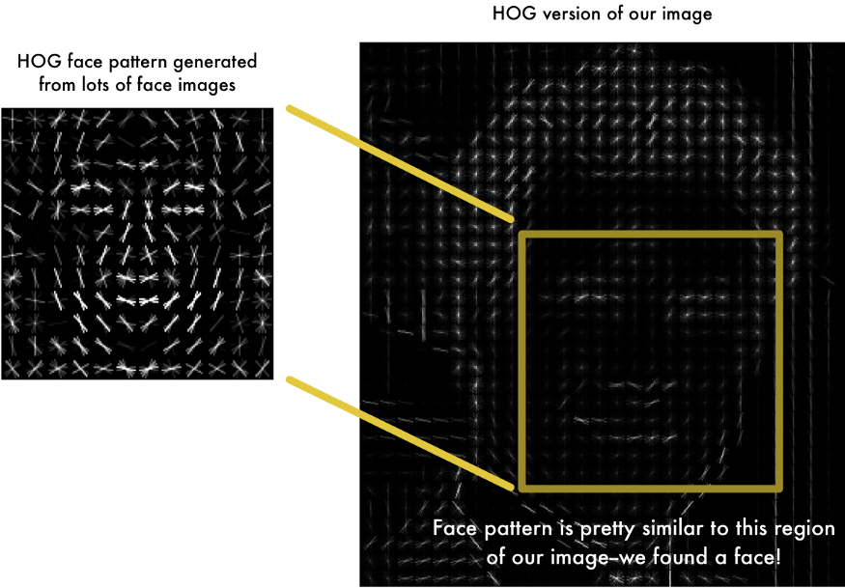
IMPLEMENTATION

Slide 14
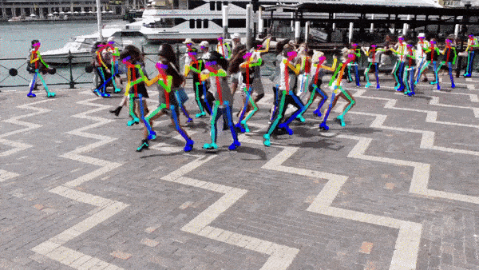
IMPLEMENTATION
OpenPose has represented the first real-time multi-person system to jointly detect human body, hand, facial, and foot keypoints (in total 135 keypoints) on single images.
OpenPose uses CMU Panoptic Dataset for training the model.
It has the capacity to detect multiple people and each of their actions.

Slide 15
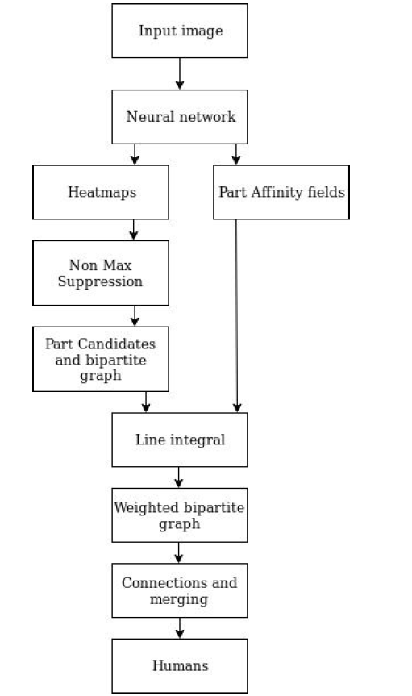
IMPLEMENTATION
Working of OpenPose

Slide 16
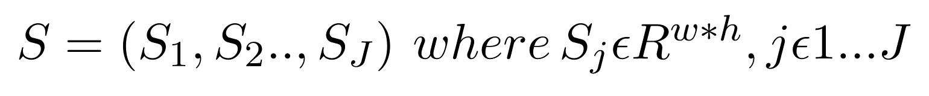
IMPLEMENTATION
Confidence Maps - A Confidence Map is a 2D representation of the belief that a particular body part can be located in any given pixel. Confidence Maps are described by following equation:
Part Affinity Fields - Part Affinity is a set of 2D vector fields that encodes location and orientation of limbs of different people in the image. It encodes thee data in the form of pairwise connections between body parts.

Slide 17
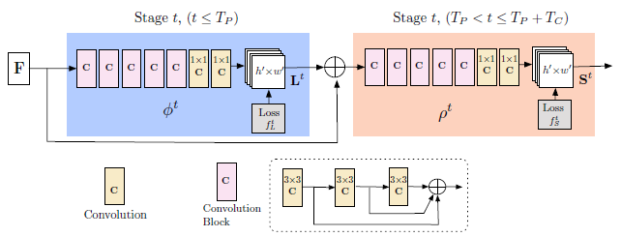
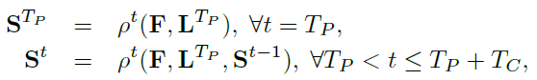
IMPLEMENTATION
Multi Stage CNN

Slide 18
RESULTS

Slide 19
CONCLUSION
Our system proposes a contactless attendance and sanitization monitoring system in a office space.
It uses new technologies which are constantly supported and updated.

Slide 20
REFERENCES
[1] Xudong Sun, Pengcheng Wu, Steven C.H. Hoi “Face Detection using Deep Learning: An Improved Faster RCNN Approach” , eprint arXiv:1701.08289v1 [cs.CV] 28 Jan 2017
[2] Sharma S, Karthikeyan Shanmugasundaram, Sathees Kumar Ramasamy, “FAREC-CNN Based Efficient Face Recognition Technique Using Dlib”, 2016 International Conference on Advanced Communication Control and Computing Technologies (ICACCCT)
[3] Zhe Cao, Student Member, IEEE, Gines Hidalgo, Student Member, IEEE, Tomas Simon, Shih-En Wei, and Yaser Sheikh, “OpenPose: Realtime Multi-Person 2D Pose Estimation using Part Affinity Fields ”, eprint arXiv:1812.08008v2 [cs.CV] 30 May 2019
[4] Tomas Simon, Hanbyul Joo, Iain Matthews and Yaser Sheikh, “ Hand Keypoint Detection in Single Images using Multiview Bootstrapping”, CVPR, 2017
[5] Tejashree Dhawle, Urvashi Ukey, Rakshandha Choudante, “Face Detection and Recognition using OpenCV and Python”

Slide 21
SUGGESTIONS….!

Slide 22
THANK YOU!!!

